Slide 1
Excel Basics continued
Module 02
‘Tell me and I forget. Teach me and I remember. Involve me and I learn.’ –Benjamin Franklin

Slide 2
Agenda
Advanced functions (Roundup, etc.)
Functionality
Create a table with totals on bottom, side and cumulative
Show sorting and auto filtering
Charts
Manual Gantt chart
Standard Deviation
Add columns to time phased data (including the graph)

Slide 3
Functions
Find advanced functions and use several
Create a table with row and column totals

Slide 4
Advanced Functions
Simple Math Operators
+ (add), -(subtract), *(multiply), /(divide), ^(power)
Some Useful Functions
SUM (totals a range)
POWER (same as ^), SQRT (square root), SUMSQ (sum of the squares)
ROUND (rounds up or down), ROUNDUP (rounds away from 0) ROUNDDOWN (rounds towards 0), TRUNC (truncates towards 0-whole integer)
Many …many more functions

Slide 5
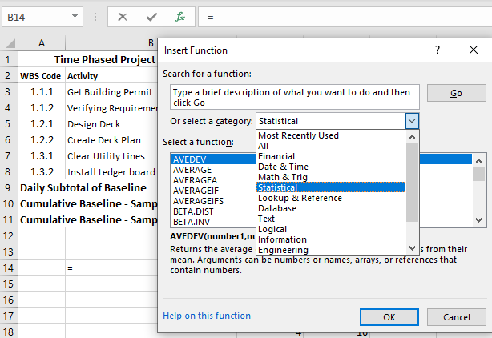
Advanced Functions – More…
Functions
Function Types
Available Functions by Type

Slide 6
Function Complete Help
Mandatory Variable
Mandatory Variable
=SQRT(number)
Requires only 1 number
=SUM(number1, [number 2], …)
Requires at least 1 number
Can have 2 numbers (square brackets means optional)
up to many
Optional Variable
Many more

Slide 7
Math Operations and Functions Exercise
In a blank worksheet complete:
Math operations: +,-,*,/,^
Functions:
SUM
POWER
ROUND
ROUNDDOWN
SQRT
SUMSQ
Show how to access the functions and the autocomplete list
Calculate standard deviation
Complete the setup of the Module 2 sheet
Module 2
Exercise 1

Slide 8
Cumulative Data and Std. Dev.
Create a table with cumulative totals
Using addition technique
Using SUM with absolute and relative referencing
Standard Deviation using SUM, AVERAGE, SQRT and STDDEV.P

Slide 9
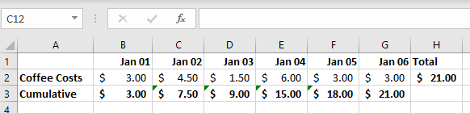
Cumulative Rows/Columns
Cumulative rows are used to show the total from the beginning of the series to current point.
Example:
If you track your coffee spending each day in a spreadsheet you would have a total each day.
This is great but what happens if I asked the question, “How much have you spent so far this month?”
That’s when a cumulative total would help!

Slide 10
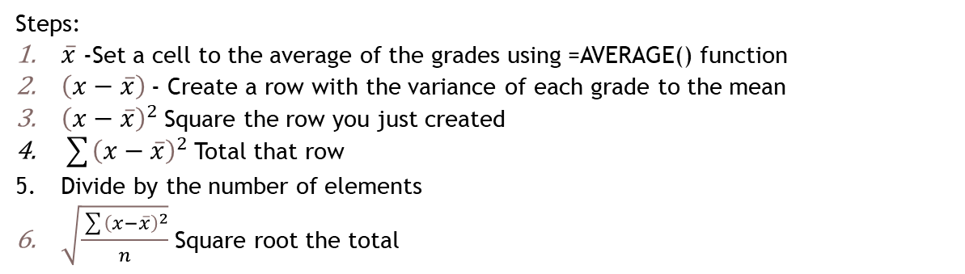
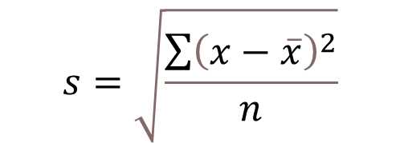
Standard Deviation of student grades
$$s=\sqrt{\frac{\sum{{\left(x−\overline{x}\right)}^{2}}}{n}}$$
Use:
n when it is the whole population
(n-1) when it is a sample/estimate
Steps:
$\overline{x}$ -Set a cell to the average of the grades using =AVERAGE() function
$\left(x−\overline{x}\right)$- Create a row with the variance of each grade to the mean
${\left(x−\overline{x}\right)}^{2}$Square the row you just created
$\sum{{\left(x−\overline{x}\right)}^{2}}$Total that row
Divide by the number of elements
$\sqrt{\frac{\sum{{\left(x−\overline{x}\right)}^{2}}}{n}}$Square root the total

Slide 11
Standard Deviation function
A
B
C
D
E
F
G
H
I
J
K
1
2
Step 2:
Variance to Mean
Step 3:
Square of the differences
Or
Use Standard deviation function:
=STDDEV.P(B2:K2)
Step 1:
Calculate Mean (Average of Grades
Step 6:
Square root the total
Step 5:
Average of the differences
Step 4:
Total of square of differences

Slide 12
Math Operations and Functions Exercise
Add cumulative rows to our Module 2 Exercise
Add alternate cumulative to our Module 2 Exercise
Use Standard Deviation sheet to calculate std. dev.
This Exercise demonstrates Excel functions, absolute and relative references, formatting and cumulative totals
Module 2
Exercise 2

Slide 13
Sorting and Filtering
Manual Sort
Autofilter

Slide 14
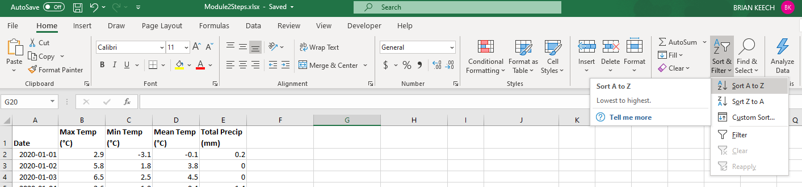
Sorting and filtering
Options:
Sort selected data A to Z
Sort selected data Z to A
Create a custom sort
Create an auto filter

Slide 15
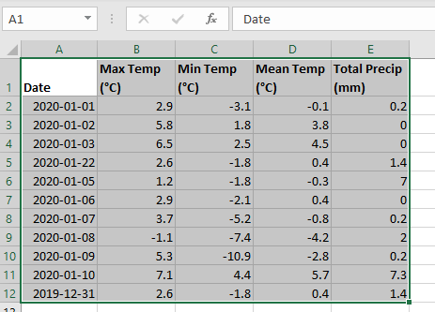
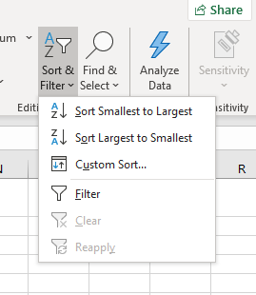
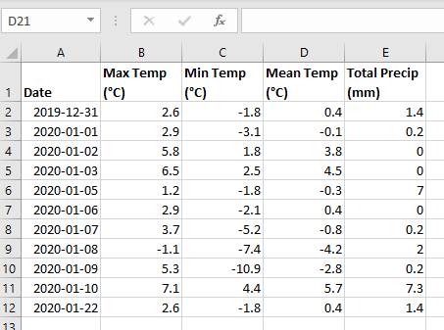
Sort
Select Sort Order
Sorts by first column
Select Area to Sort
Warning: If you do not select all the columns the data will not stay together. Excel only sorts the selected information.

Slide 16
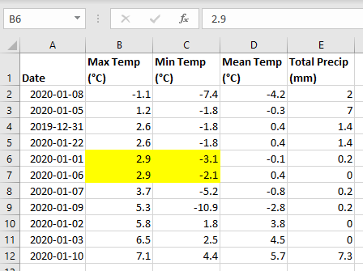
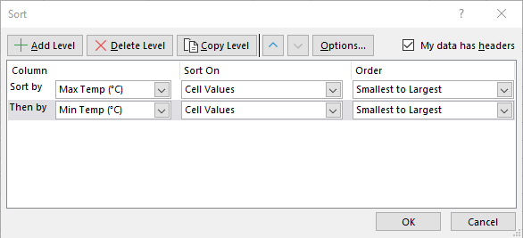
Sort
Select Custom Sort
Add columns you want sorted
Select Area to Sort
Level 1
Level 2

Slide 17
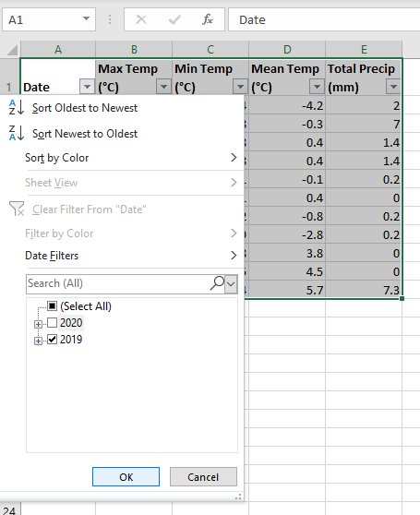
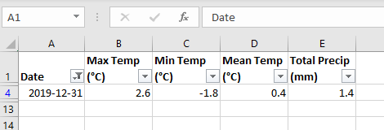
Sort
Select Filter
Filter Indicator
Select Area to Sort
Select 2019
Only 1 row
Shows Filter Applied

Slide 18
Sorting and Filtering Exercise
Filter a range of data
Set up a custom sort
Set up auto filter
Practice using each
Demonstrate effect of not selecting all columns or rows when sorting (bad thing)
Demonstrate the custom sort dialog box
Demonstrate autofilter features
Module 2
Exercise 3

Slide 19
Create a simple Chart
Components of a Chart
Create a simple chart
Edit the axis of a data series

Slide 20
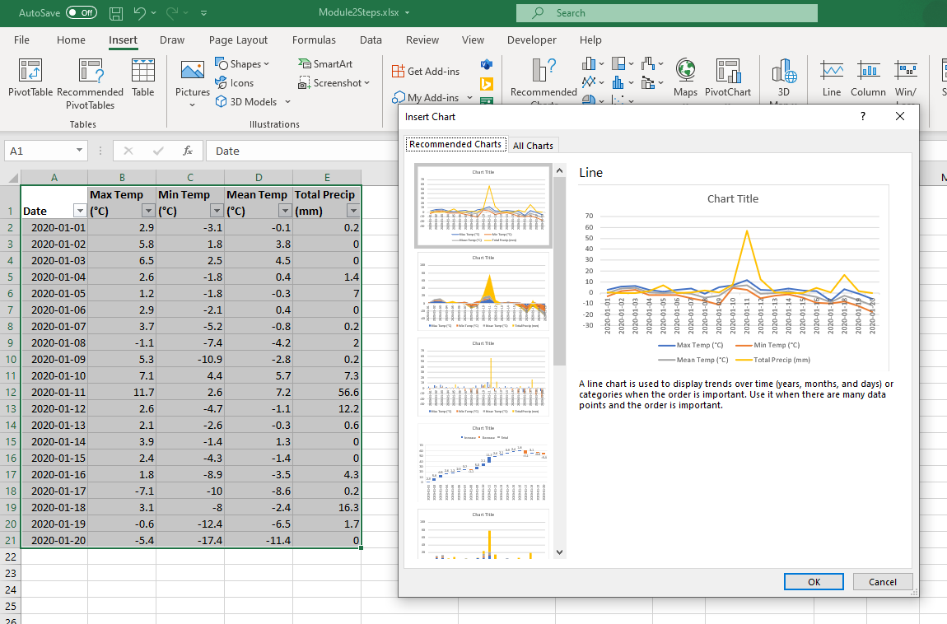
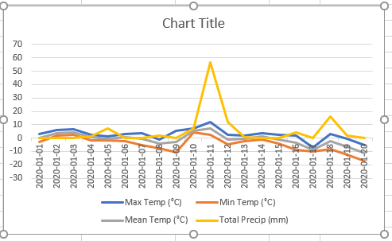
Chart - Creating
Select Recommended Charts
Select Line Chart
Select OK
Select Area to Chart

Slide 21
Charts – Components of a Chart
Chart Title
Y-Axis Title
Series Values
Y-Axis Labels
Legend
X-Axis Title
X-Axis Labels

Slide 22
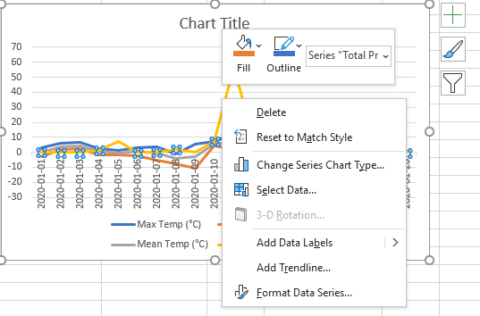
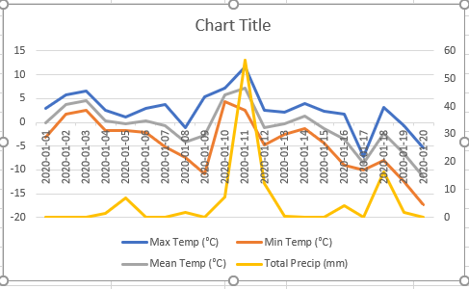
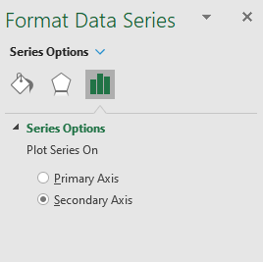
Charts – Format a data series – Change Axis
Primary Axis
Secondary Axis
Select Yellow Data Series
Select Format Data Series
Select Secondary Axis

Slide 23
Sorting and Filtering Exercise
Create a chart
Alter the # of series on a chart
Create an alternate axis
Demonstrate the various attributes that can be changed on a chart and the menu items that are available
Module 2
Exercise 4

Slide 24
Create a Manual Gantt Chart
Create a manual Gantt chart
Alter time phased data

Slide 25
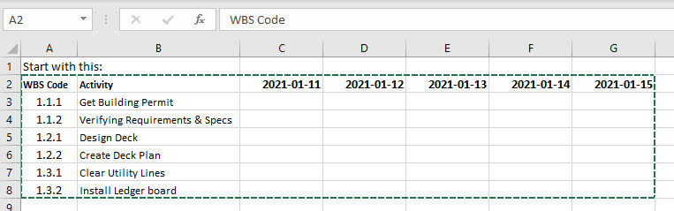
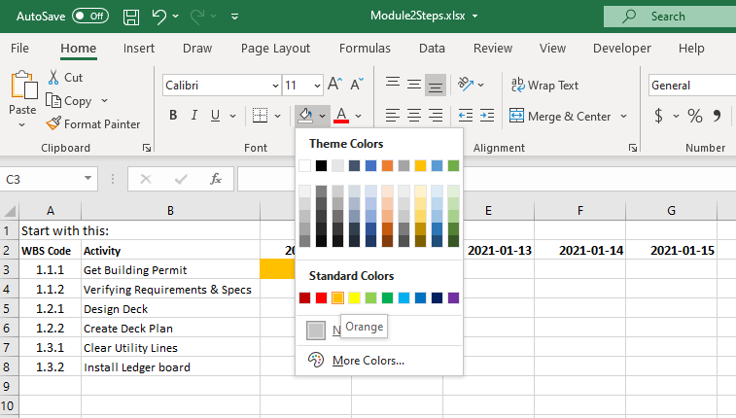
Manual gantt chart
Start with Activities and Dates
Select a cell (date and activity)
Select fill icon
Select fill color

Slide 26
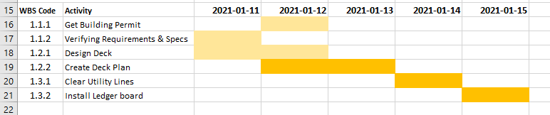
Completed Gantt Chart
Dates
Activities (Tasks)
Different Colors

Slide 27
Manual Gantt Chart Exercise
Create a manual Gantt chart
Module 2
Exercise 5

Slide 28
Altering Time Phased Data
Adding to time phased data

Slide 29
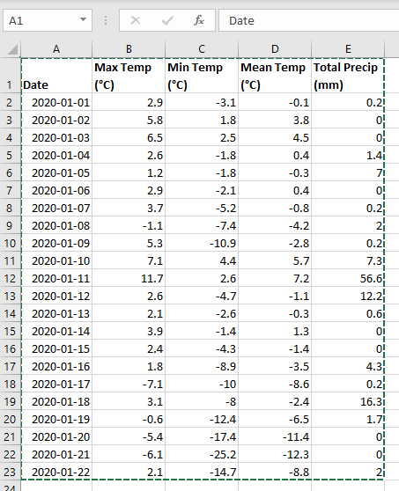
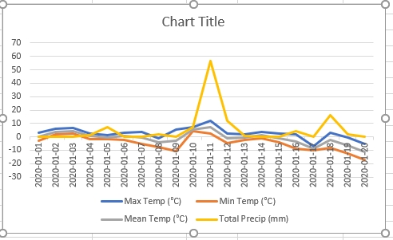
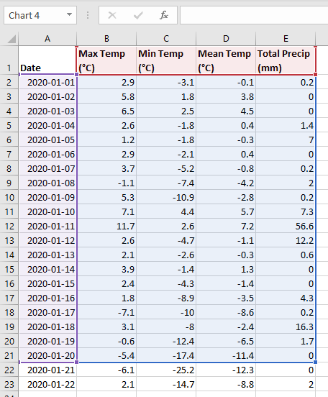
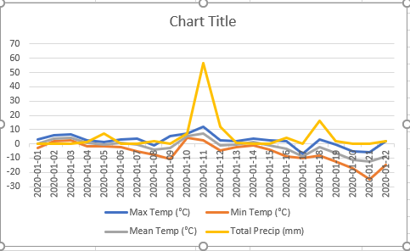
Altering (adding to) Time Phased data
Added 2 new rows of data
Click on Chart
New data Added
Drag to add new rows

Slide 30
Adding to Time Phased data
Show how to added more data to a chart
Show how to expand a formula such as =SUM()
Module 2
Exercise 6

Slide 31
A few other Things
Link a cell from a different Worksheet
Workbook/Worksheet Protection

Slide 32
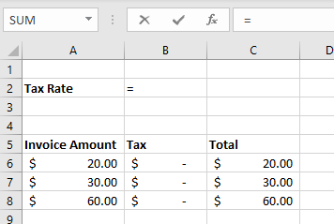
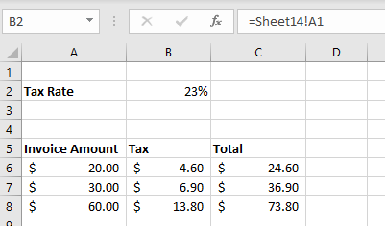
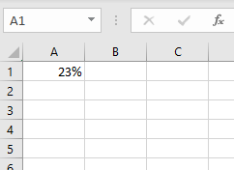
Links from other Worksheets
Sheet reference in formula
Number appears
Enter “=“ in a cell
Numbers Updated
Goto Different Sheet and select cell and press Enter

Slide 33
Worksheet/workbook Protection
Workbook
Used to workbook from being changed
Prevents any worksheet actions
Can be password protect (somewhat secure)
Worksheet
Used to prevent changes to “some” parts of a worksheet
Many options on what to protect
Can be password protected (somewhat secure)
Can be used to prevent accidental changes

Slide 34
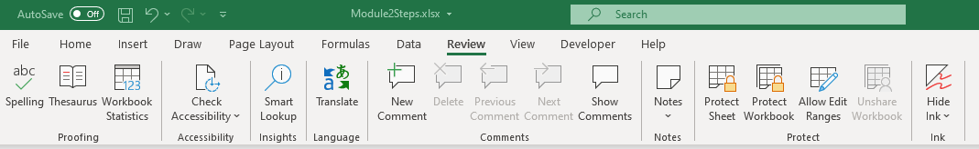
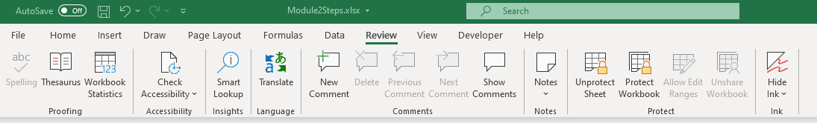
Worksheet/workbook Protection
Worksheet is unprotected
Click to bring up protection Dialog
Worksheet is protected
Click unprotect

Slide 35
Extra Topics Exercise
Create links to other worksheets
Protect and unprotect worksheets and workbooks
Module 2
Exercise 7

Slide 36
Looking Forward
Assignment – see FOL for details and due date
Review next Module content
Install MS Project – see directions in FOL

